Slide 1

AI-Powered Image Tagging using Generative & Vision-Language Models

Slide 2
INTRODUCTION
This presentation explores an innovative approach to automated image
tagging, leveraging the power of generative and vision-language models. Our method combines BLIP, KeyBERT, and CLIP to achieve highly accurate, context-aware image tagging, enabling various applications such as content moderation, smart photo albums, and automated social media tagging.

Slide 3
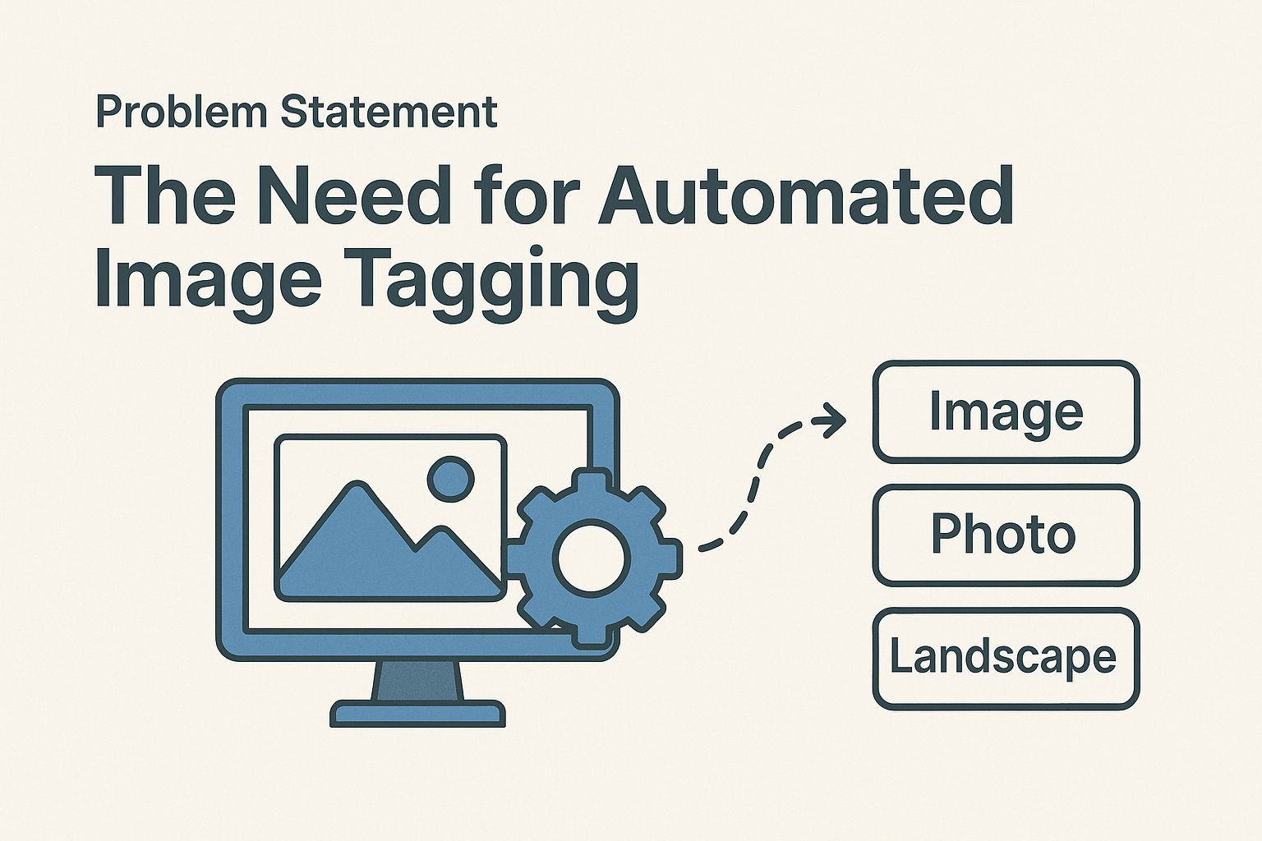

Problem Statement: The Need for Automated Image Tagging
Manual image tagging is a labor-intensive, time-consuming, and inconsistent
Use Case Examples
Instagram/Pinterest-style auto-tags
Content moderation and discovery
Smart photo albums
process. The need for an automated, high-quality, and context-aware image
tagging solution is paramount. Automatic image tagging has the potential to
revolutionize various industries, enhancing content moderation, streamlining
image search, and facilitating the creation of smart photo albums.
Tedious and time-consuming
Inconsistent and subjective
Not scalable to large image datasets

Slide 4

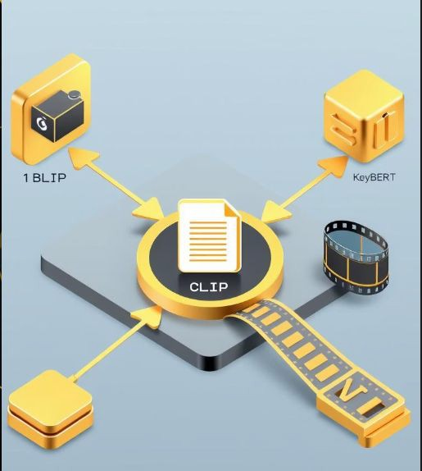
Solution Overview: BLIP + KeyBERT + CLIP Stack
Image Input
Raw image as input.
BLIP Captioning
Generates a context-aware caption using BLIP.
KeyBERT Tag Extraction
Extracts keywords using KeyBERT from the generated caption.
CLIP Relevance Scoring
Uses CLIP to ﬁlter and retain only visually relevant tags.
Final Tags
Outputs the reﬁned set of tags.
Our solution leverages the strengths of three powerful models: BLIP, KeyBERT, and CLIP. The process begins with generating a descriptive caption of the input image using BLIP, followed by extracting relevant keywords from the caption using KeyBERT. Finally, CLIP is employed to assess the visual relevance of each tag, ensuring high-precision image tagging.

Slide 5





Tools & Technologies: The Building Blocks
BLIP
Vision-Language Captioning
KeyBERT
Keyword Extraction (BERT
CLIP
Image-Text Similarity (OpenAI)
(Salesforce)
embeddings)
PyTorch
Deep Learning Framework
Our project utilizes a combination of cutting-edge tools and technologies to achieve accurate and efficient image tagging. We leverage the power of BLIP for vision-language captioning, KeyBERT for keyword extraction, and CLIP for image-text similarity. These tools are built upon the foundation of Transformers,
Sentence-Transformers, PyTorch, and are implemented within a Jupyter Notebook environment.

Slide 6
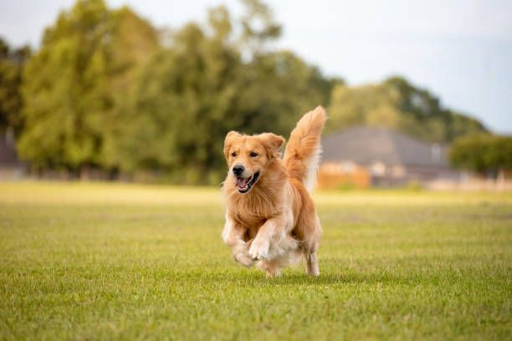
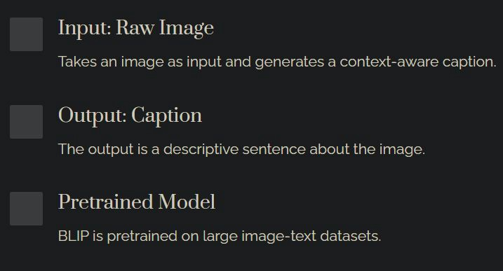
How BLIP Works: Generating Context-Aware Captions
BLIP (Bootstrapping Language-Image Pre-training) is a vision-language
model developed by Salesforce. It is pre-trained on large image-text datasets to generate descriptive and context-aware captions for input images. BLIP excels at capturing the nuances and details of an image, providing a rich textual representation for downstream tasks.
Pretrained on large image-text datasets
Generates descriptive captions
Example: Image: [ image of a dog running in a ﬁeld].
Captures image nuances and details
Caption: “A dog running across a grassy ﬁeld on a sunny day”.

Slide 7
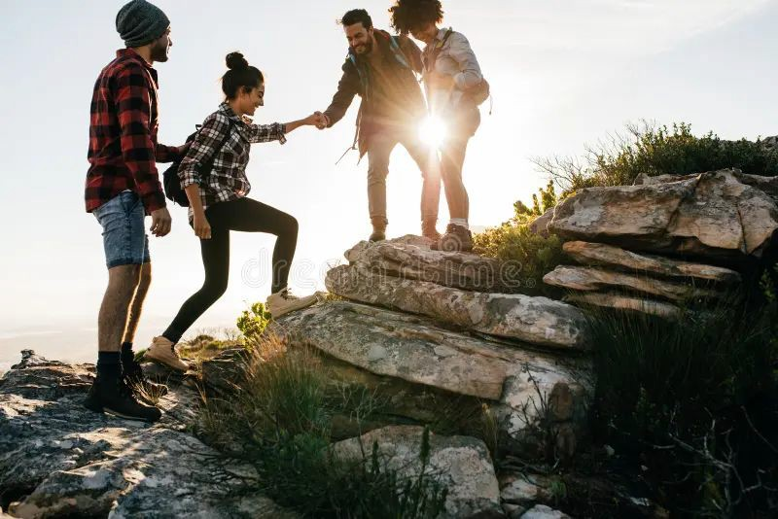
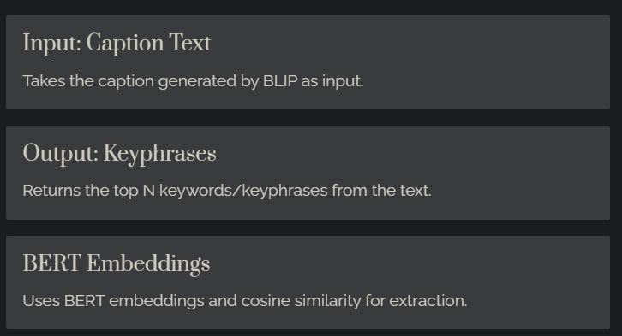
How KeyBERT Works: Extracting Relevant Keywords
KeyBERT is a keyword extraction technique that leverages BERT
embeddings to identify the most relevant keywords or key phrases from a given text. By calculating the cosine similarity between the text embedding and the embeddings of candidate keywords, KeyBERT effectively extracts the terms that best represent the content.
Uses BERT embeddings + cosine similarity
Removes stopwords
Example: Caption: "A group of friends hiking in the mountains during sunset".
Supports n-grams
Tags: [“hiking”, “mountains”, “friends”, “sunset”].

Slide 8




How CLIP Filters Tags: Ensuring Visual Relevance
Image Input
Input Image
Tag Input
Extracted Keyword Tag
1
2
Similarity Score
Cosine similarity > 0.25
CLIP Embedding
Embed both image and tag.
4
3
CLIP (Contrastive Language-Image Pre-training) is a neural network trained by OpenAI to learn relationships between images and text. In our
project, CLIP plays a crucial role in ﬁltering the extracted tags, ensuring that only visually relevant tags are retained. CLIP embeds both the input image and each tag, compares their similarity, and ﬁlters out tags that do not meet a predeﬁned relevance threshold.

Slide 9
Implementation Flow: From Image to Tagged Output
Fetch Image
Fetch image from URL or input
1
Generate Caption
Generate caption using BLIP
2
Extract Tags
Extract tags using KeyBERT
3
Filter Tags
Filter tags using CLIP
4
Output
Output caption and ﬁnal tags
5
The implementation flow of our AI-powered image tagging system can be summarized in the following steps: 1. Fetch image from URL or input. 2. Generate caption using BLIP. 3.
Extract tags using KeyBERT. 4. Filter tags using CLIP. 5. Output the generated caption along with the ﬁnal, visually relevant tags.

Slide 10

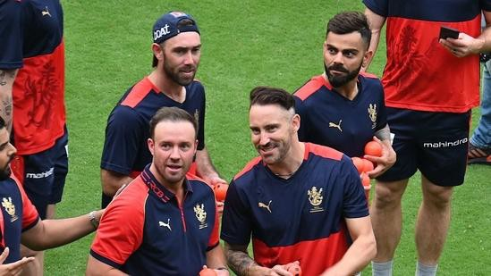
Results: High-Precision Image Tagging in Action
Example Image
Generated Caption: the players are all smiles as they walk on the ﬁeld
Example Image
Generated Caption: a city skyline.
Extracted Tags: 'players smiles', 'smiles walk', 'walk ﬁeld', 'players', 'smiles'
Extracted Tags: 'city skyline', 'skyline', 'city'
Final Tags: 'players smiles', 'players' Final Tags: 'city skyline', 'skyline', 'city'
Here we can see some examples of the power of our AI-Powered Image Tagging System. We can see the generated caption, the extracted tags, and the ﬁnal tags for each image.

Slide 11





Advantages: Accurate, Scalable, and Versatile
Highly Accurate
Contextual image tagging
Zero-Shot
Works on unseen domains
Scalable
Fast and efficient processing
Versatile
Can be integrated into content platforms
This AI-powered image tagging system offers numerous advantages over traditional manual tagging methods. The system is highly accurate, providing contextual image tagging that captures the nuances of each image. It works on unseen domains in a zero-shot manner, eliminating the need for extensive training data.

Slide 12
Limitations & Future Scope
1
Limitations
Relies on pre-trained model quality.
Requires the internet for model loading.
2
Future Scope
Adding support for multiple languages.
Fine-tuning for speciﬁc domains.
Wrapping the tool into an API.

Slide 13
Conclusion
1
AI-Driven Pipeline
We built an AI pipeline to
2
Accurate Tagging
Our system ensures accurate and
3
Combining Techniques
Combines the best of captioning,
automatically generate image
visually relevant tags for each
keyword extraction, and
tags.
image.
vision-language relevance.

Slide 14


Demo
Interactive demos showcase the system in action.
They allow users to test the image tagging with their images. Check out our Google Colab demo!
https://github.com/hemu-08/ai_powered_image_taggling

Slide 15
Thank You

